Slide 1

AI-Powered System for Translating Educational Content and Generating Regionally Accurate Subtitles
IOMP BATCH-IT-25-21
ABDUL MUQTADIR -22261A1201
SOWDAGAR ROSHAN NAVEED -22261A1252
GUIDE:
Dr. D. VIJAYA LAKSHMI

Slide 2
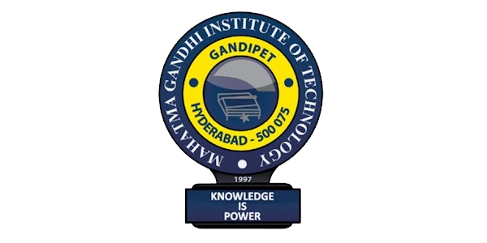
MAHATMA GANDHI INSTITUTE OF TECHNOLOGY (A) DEPARTMENT OF INFORMATION TECHNOLOGY
An Industry Oriented Mini Project (IT)
on
AI System for Translating Educational Content with Accurate Regional Subtitles
by
Abdul Muqtadir -22261A1201
Roshan Naveed -22261A1252
Batch ID : IT-25-21
Internal Supervisor
IOMP Supervisor
Dr .U.Chaitanya
Assistant Professor
Dr. D. VIJAYA LAKSHMI
HOD,IT

Slide 3
ABSTRACT
As digital education continues to expand globally, language barriers remain a significant obstacle, limiting access to learning for diverse linguistic communities. Many students struggle to comprehend educational content that is not available in their native language, creating a gap in knowledge accessibility. Addressing this challenge requires innovative solutions that ensure inclusivity in digital learning environments.
This project introduces an AI-powered system designed to transcribe, translate, and generate regionally accurate subtitles for educational content. By leveraging advanced technologies, the system enhances accessibility and comprehension, making learning materials more inclusive for non-native speakers.
The system integrates AssemblyAI for high-accuracy speech-to-text transcription, DeepTranslator for contextual language translation, and FFmpeg for seamless subtitle embedding. These technologies work together to deliver precise, context-aware translations while ensuring accurate subtitle synchronization, improving the overall learning experience.
Utilizing cutting-edge Natural Language Processing (NLP) and Speech-to-Text (STT) technologies, this solution guarantees high-quality transcription and translation, making it an effective tool for multilingual education. The AI-driven approach ensures that subtitles are not only linguistically accurate but also culturally and contextually relevant.
Designed to be scalable and adaptable, the system can be implemented across various educational platforms, enabling a wider audience to benefit from digital learning. By breaking down language barriers, this innovative solution bridges the gap in education, making knowledge more universally accessible and fostering a more inclusive learning environment.

Slide 4
INTRODUCTION
With the growing reach of digital education, video-based learning platforms like YouTube have become essential tools for knowledge dissemination. However, a major barrier to inclusive learning remains: language diversity. Millions of students and lifelong learners struggle to understand educational videos that are not in their native languages. In multilingual regions, this language gap contributes to educational inequality, limiting access to critical information and resources.
Traditional methods of subtitling, such as manual transcription and translation, are time-consuming, expensive, and difficult to scale. Moreover, these approaches often fail to preserve speaker context and accuracy in dynamic conversational content, especially in multi-speaker educational scenarios like lectures, interviews, and webinars. The lack of automated, accurate, and regionally sensitive subtitle generation tools leaves a significant portion of educational content inaccessible to non-English speakers.

Slide 5
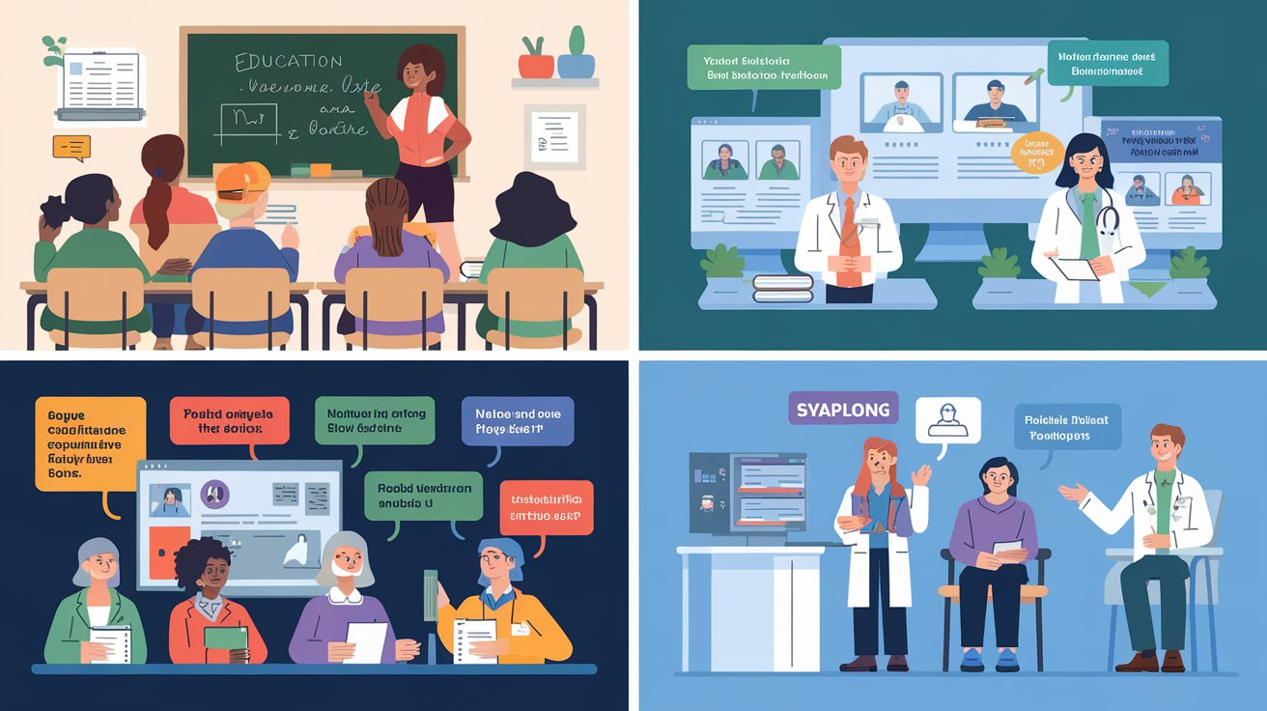
INTRODUCTION
Language Barriers in Education: Many students struggle to access educational content due to the limited availability of resources in their native languages.
AI-Powered Solution: The proposed system aims to bridge this gap by translating educational content and generating regionally accurate subtitles.
Seamless Integration: Designed for smooth integration into digital learning platforms, making educational content accessible to a wider audience.
Bridging the Education Gap: By overcoming language barriers, the system enhances accessibility, ensuring students worldwide can effectively engage with learning materials.

Slide 6
EXISTING SYSTEM
Existing subtitle generation systems typically fall into two categories: manual transcription and translation services, or basic automated tools integrated within platforms like YouTube or commercial transcription software. These systems provide limited functionality and are often designed for generic use cases, not specifically for educational content.
YouTube’s auto-captioning, for example, offers real-time subtitles, but struggles with subject-specific terminology, multi-speaker differentiation, and often produces incorrect or contextually inaccurate translations. Other commercial tools like Otter.ai and Sonix provide transcription services but require separate manual steps for translation and subtitle formatting. Moreover, these tools are often limited in their language support, especially when it comes to regional Indian or African languages.
Most of these systems also lack integration capabilities with custom educational workflows, do not offer open-source flexibility, and fail to preserve speaker context—an essential feature for understanding lectures, debates, or interviews. Furthermore, very few systems support end-to-end automation from video input to translated, embedded subtitle output.
In summary, current systems are not designed to handle the accuracy, automation, and adaptability required for multilingual educational content delivery. This creates a significant opportunity to develop an intelligent solution that fills the gap.

Slide 7
Proposed Solution
The proposed system aims to automate the process of generating translated subtitles with speaker identification for video content, enhancing accessibility and user engagement across linguistic boundaries. This solution addresses the manual and time-intensive limitations of traditional subtitling and translation workflows. By integrating AssemblyAI for transcription and speaker labeling, and Google Translate for multilingual translation, the system ensures high-quality, speaker-specific subtitles that are both accurate and context-aware.
A key innovation of the system is its ability to accept either uploaded videos or YouTube URLs, enabling flexibility in content sources. Once a video is provided, the system extracts audio using FFmpeg and transcribes it using AssemblyAI’s API with speaker labels. The transcribed segments are then broken into manageable chunks and translated into the selected language. Finally, the translated and speaker-labeled content is formatted into .srt subtitle files and embedded back into the original video using FFmpeg.

Slide 8
Applications
Education: Making global educational content accessible to local communities in their own languages. Corporate Training: Multilingual employee training materials with regionally accurate subtitles. Healthcare and Public Services: Providing medical and legal content in multiple languages for better outreach.

Slide 9
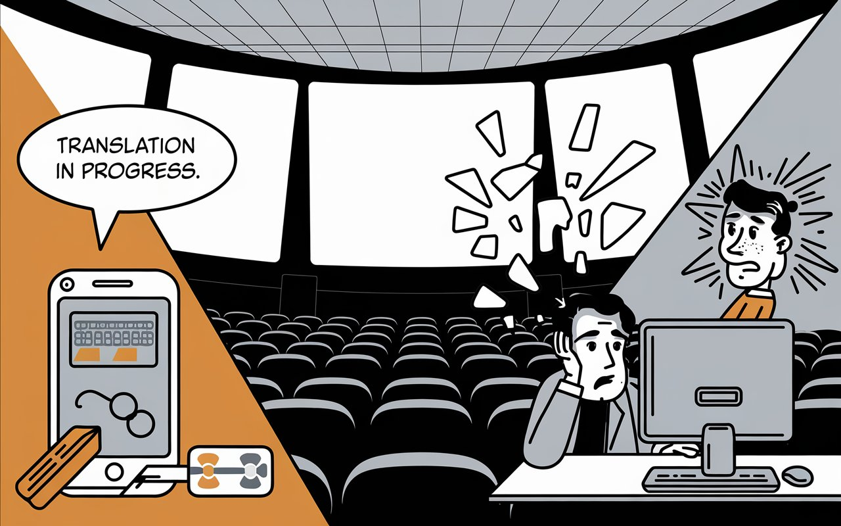
Existing Systems & Gaps
Traditional translation tools like Google Translate.
Manual subtitle creation.
Gaps in Existing Systems:
Lack of automation in translations and subtitles.
Limited support for low-resource languages.

Slide 10
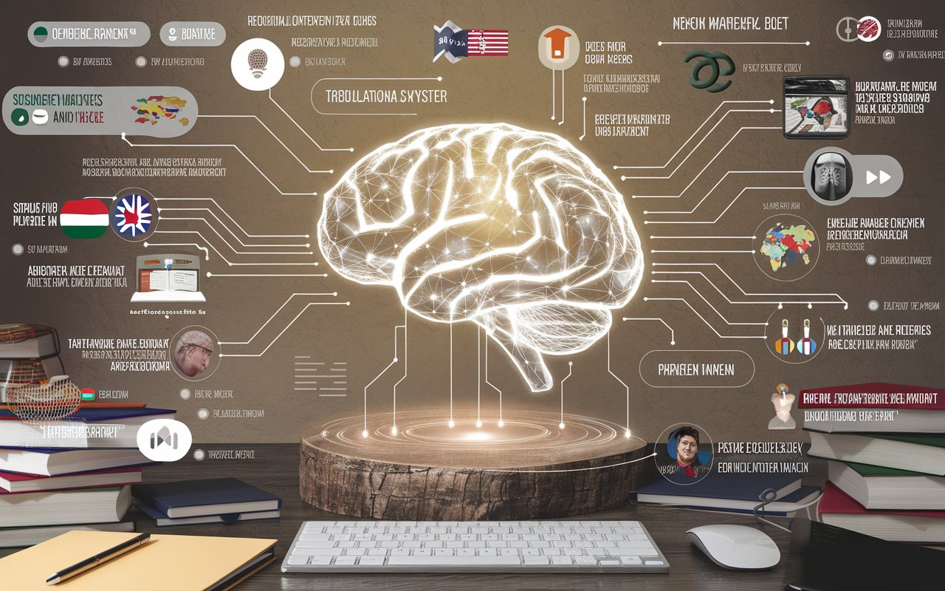
Proposed Solution
1. End-to-End Automation
Fully automated pipeline from video upload to translated output with no manual intervention
2. Enterprise-Grade Accuracy
Combines AssemblyAI's 95%+ accurate speech recognition with Google Translate's neural translation
3. Future-Proof Extensibility
Plug-in architecture for AI model

Slide 11
Applications Education: Making global educational content accessible to local communities in their own languages. Corporate Training: Multilingual employee training materials with regionally accurate subtitles. Healthcare and Public Services: Providing medical and legal content in multiple languages for better outreach.

Slide 12
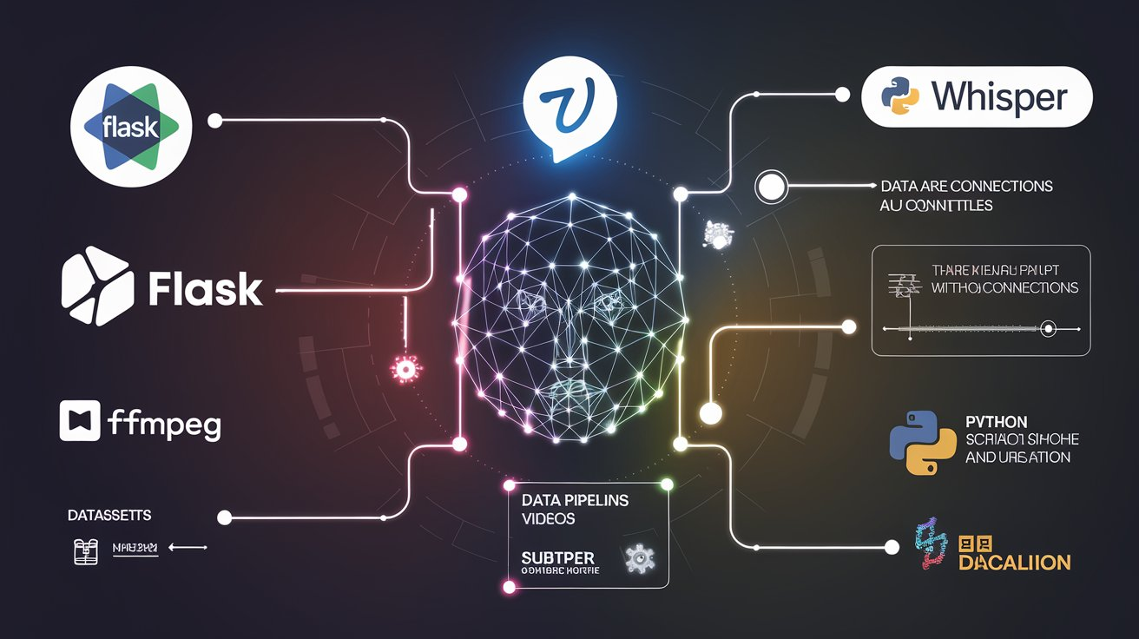
Hardware and Software
Flask for Web Application
Deep Translator for Translation
Assemblyai Transcription
FFmpeg for Video Processing
Python for NLP-based Processing
Processing Unit (CPU & GPU)
Memory (RAM) Min-8GB
Storage
Network & Connectivity

Slide 13
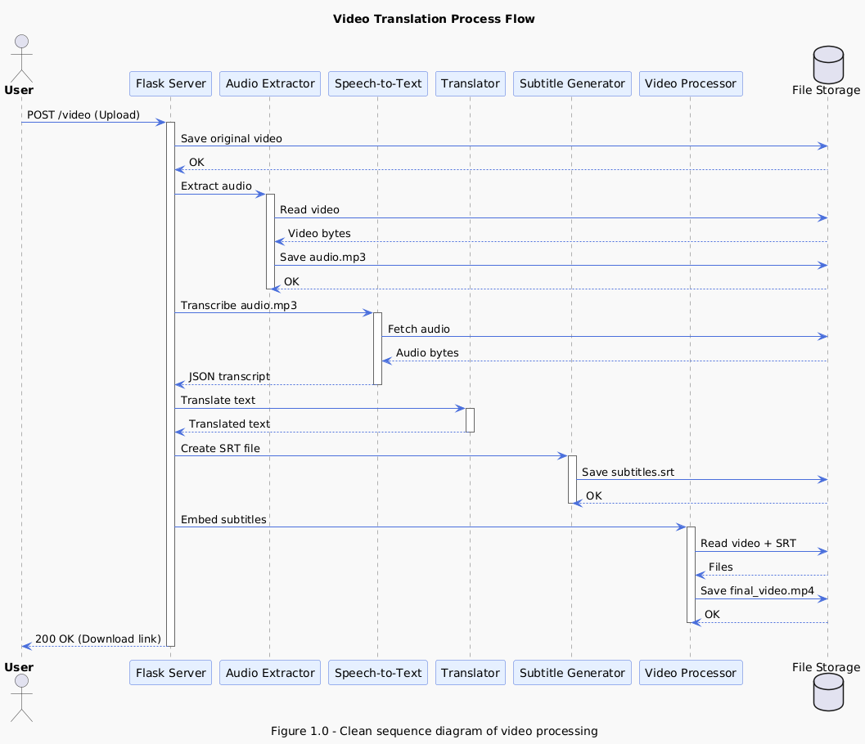
Process flow architecture for AI-Powered System for Translating Educational Content and Generating Regionally Accurate Subtitles

Slide 14
Literature Survey
Paper Title | Authors | Objective | Techniques/Tools Used | Languages/Modalities Covered | Innovations/Highlights | Limitations
sign.mt: Real-Time Multilingual Sign Language Translation Application | Amit Moryossef | Real-time, offline, multilingual translation between spoken and signed languages | Modular architecture; MediaPipe, cld3, ChatGPT, Pose sequence generation; 3D Avatars | Multilingual, spoken-to-signed and vice versa | Open-source, modular, client-side deployment, customizable avatars | Still experimental; baseline SignWriting-to-pose is limited​
Real-Time Multilingual Sign Language Processing (PhD Thesis) | Amit Moryossef | Holistic framework for SLP tasks: segmentation, translation, production, animation | SignWriting, pose estimation, NLP & CV integration, DNNs | Multilingual, with focus on American Sign Language | Proposed SignWriting as a universal transcription; built foundational tools/datasets | Lacks wide community adoption for universal transcription​
Automatic Subtitle Synchronization and Positioning System | Bogdan Mocanu, Ruxandra Tapu | Auto-synchronization of subtitles with speech and optimal on-screen positioning | ASR + Closed caption alignment, timestamp refinement, CSA-compliant timing, semantic scene analysis | Spoken language (French TV), subtitles | Fully automatic sync and dynamic positioning; real-world tested | Depends on ASR accuracy; not sign language-specific​
Automatic Lecture Subtitle Generation and How It Helps | Xiaoyin Che et al. | Subtitle generation for MOOCs, with bilingual output | IBM Watson ASR, Sentence Boundary Detection using DNNs, MT (English ↔ Chinese) | English, Chinese (text only) | Cuts editing time by 54%; integrated pipeline | MT to Chinese less accurate; requires manual touch-ups​
Machine Translation of English Videos to Indian Regional Languages | Srikar K. Pulipaka et al. | Translate English video content into Indian regional languages using open-source tools | ffmpeg, IBM Watson STT, Google Translate API, Flite TTS | English to Indian languages (speech) | End-to-end translation & TTS pipeline for low-resource regions | Limited TTS availability for Indian languages; accuracy varies (avg. 79%)​

Slide 15
Literature Survey
S.NO | AUTHOR NAMES, YEAR OF PUBLICATION | JOURNAL OR CONFERENCE NAME AND PUBLISHER NAME | METHODOLOGY / ALGORITHM / TECHNIQUES USED | MERITS | DEMERITS | RESEARCH GAPS
1 | Amit Moryossef, PhD Thesis (2023) | IEE | Sign Language Processing with glosses, SignWriting, segmentation, baseline gloss-to-sign models | Unified intermediate notation for multilingual SLP | Linear glosses lose simultaneity info; SignWriting not widely adopted | Require better tools for SignWriting annotation and real-world deployment validation
2 | Amit Moryossef et al., (2023) | IEEE | sign.mt: Modular pipeline for real-time sign language translation using STT, SignWriting, Pose Estimation, GANs | Multilingual, modular, customizable avatar rendering | Incomplete SignWriting-to-Pose model; offline components need refinement | Need for generalized models across sign languages; expand SignWriting datasets
3 | Srikar Pulipaka et al., (2019) | IEEE | IBM Watson STT + Google Translate + Flite TTS (English to Indian Languages) | 91% single-video accuracy; useful for visually impaired | Avg. accuracy 79%; lack of robust open-source TTS for Indian langs | Better TTS needed for regional dialects; lack of contextual translation
4 | Bogdan Mocanu & Ruxandra Tapu (2021) | IEEE ACCESS | ASR + Subtitle/Audio Alignment + Semantic Subtitle Positioning | >90% accuracy in synchronization; user-validated UI for hearing impaired | ASR accuracy limited by language and noise | Lack of real-time implementation; doesn't work for live subtitles
5 | ChenYao et al., (2018) | IEEE | Automatic Lecture Subtitle Generation using ASR, SBD (DNN-based), MT | Saves 54% of human effort; 54.3% reduction in error | English to Chinese has low effectiveness | Need for improved MT quality and better SBD tuning for various content types

Slide 16
REFERNECES
[1] B. Mocanu and R. Tapu, "Automatic Subtitle Synchronization and Positioning System Dedicated to Deaf and Hearing Impaired People," IEEE Access, vol. 9, pp. 139544-139555, 2021, doi: 10.1109/ACCESS.2021.3119201.
[2] S. Karad, A. Lahane, P. Dhamdhere, D. Thosar, S. Mane, and S. Kshirsagar, "Generation of Video Subtitles for All Video Creators," in Proceedings of the 2024 2nd DMIHER International Conference on Artificial Intelligence in Healthcare, Education and Industry (IDICAIEI), Wardha, India, 2024, pp. 1-5, doi: 10.1109/IDICAIEI61867.2024.10842907.
[3] A. Kaulage, A. Walunj, A. Bhandari, A. Dighe, and A. Sagri, "Edu-lingo: A Unified NLP Video System with Comprehensive Multilingual Subtitles," in Proceedings of the 2024 Second International Conference on Data Science and Information System (ICDSIS), Hassan, India, 2024, pp. 1-8, doi: 10.1109/ICDSIS61070.2024.10594128.
[4] S. K. Pulipaka, C. K. Kasaraneni, V. N. Sandeep Vemulapalli, and S. S. Mourya Kosaraju, "Machine Translation of English Videos to Indian Regional Languages using Open Innovation," in Proceedings of the 2019 IEEE International Symposium on Technology and Society (ISTAS), Medford, MA, USA, 2019, pp. 1-7, doi: 10.1109/ISTAS48451.2019.8937988.
[5] X. Che, S. Luo, H. Yang, and C. Meinel, "Automatic Lecture Subtitle Generation and How It Helps," in Proceedings of the 2017 IEEE 17th International Conference on Advanced Learning Technologies (ICALT), Timisoara, Romania, 2017, pp. 34-38, doi: 10.1109/ICALT.2017.11.

Slide 17
Problem Statement
In a diverse and multilingual country like India (or globally), the dissemination of educational content is often hindered by language barriers. Most high-quality educational videos are available in English or a few major languages, leaving millions of students in rural or regional areas unable to fully understand or benefit from them. Furthermore, subtitles often lack regional nuance, making it hard for native speakers to follow along effectively. This creates an urgent need for a system that can bridge the language divide in education through automation.

Slide 18
Project Objective:
The objective of this project is to develop an AI-powered system that automatically transcribes, translates, and generates regionally accurate subtitles for educational video content. The system aims to:
Bridge language barriers in digital education by supporting multiple Indian regional languages.
Provide a fully automated pipeline from audio transcription to subtitle embedding to simplify the localization process for educational institutions, content creators, and EdTech platforms.

Slide 19
Modules Description
Video Input Module
Functionality: Accepts educational videos through YouTube URLs or direct file uploads.
Technologies Used:
yt_dlp – Downloads videos in high/best quality.
Flask (HTML Form) – Takes input via web UI.
Responsibilities:
Validates YouTube URL or uploaded file format (.mp4, .avi, .mov, .mkv).
Saves videos into a temporary 'uploads' directory for processing.
2. Audio Extraction Module
Functionality: Extracts audio from the uploaded or downloaded video.
Technologies Used:
FFmpeg via Python subprocess
Responsibilities:
Generate high-quality audio files (e.g., MP3) for transcription
Maintain audio synchronization and proper channel mapping

Slide 20
3. Transcription Module
Functionality: Converts the extracted audio into a transcript with speaker labels.
Technologies Used:
AssemblyAI API
Features:
Speaker diarization (identifies individual speakers)
Breaks audio into utterance-level word chunks for subtitle segmentation
4. Translation Module
Functionality:
Translates the English transcript into a user-selected Indian language.
Technologies Used:
Deep Translator
Features:
Automatically detects source language
Supports various target languages (e.g., Hindi, Telugu, Bengali, etc.)
Language is selectable from the web interface

Slide 21
5. Subtitle Generation Module
Functionality:
Generates .srt subtitle files using translated text and timestamps.
Sample
00:00:02,000 --> 00:00:07,500
[Speaker 1] यह एक उदाहरण वाक्य है
6. Subtitle Embedding Module
Functionality: Embeds (hardcodes) the generated subtitles directly onto the video.
Technologies Used:
FFmpeg subtitle filter
Responsibilities:
Burn subtitles permanently into the video
Customize font styling for clarity

Slide 22
7. Web Interface Module
Functionality: Provides a simple and user-friendly web interface for the entire workflow.
Technologies Used:
Flask (Python) – Backend
HTML/CSS – Frontend
Features:
Upload video file or enter YouTube URL
Choose output language and video quality
Displays real-time errors or download link after processing
8. File Management & Error Handling Module
Functionality:
Handles storage and organization of files, and manages exceptions gracefully.
Responsibilities:
Organizes input and output files into folders
Displays user-friendly error messages
(Optional) Cleans up temporary files after processing

Slide 23
Algorithms
Regular Expression Matching (Regex Parsing)
Internally uses Deterministic Finite Automata (DFA) and Backtracking for pattern recognition.
Purpose: Sanitizes filenames by detecting and removing illegal characters using pattern-matching.
Chunking and Subtitle Time Synchronization
Custom Logic implemented in Python
Algorithmic Strategy:
Splits transcript into chunks of fixed word length (6 words)
Calculates start and end timestamps using datetime timedelta arithmetic
Purpose: Ensures subtitles are readable, timed correctly, and match spoken dialogue.

Slide 24
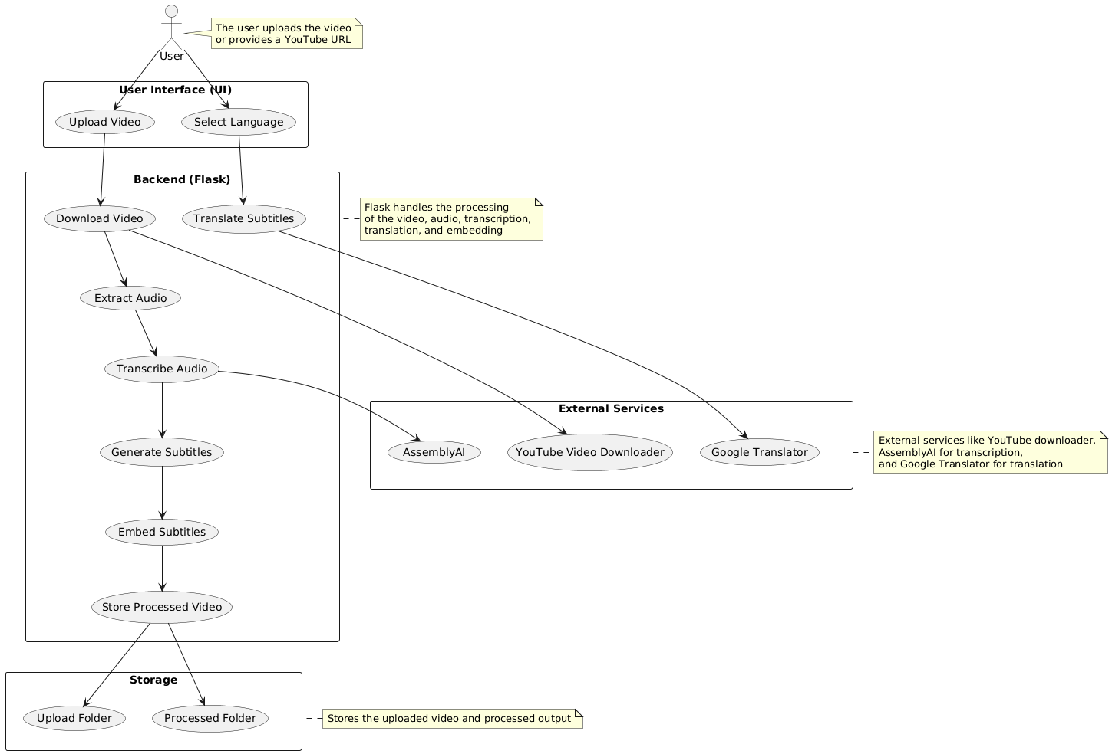
DESIGN ARCHITECTURE

Slide 25
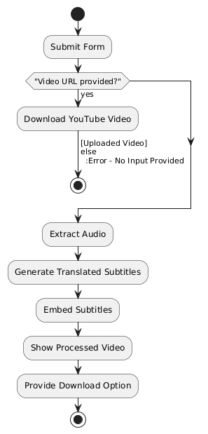
DATA FLOW DIAGRAM

Slide 26
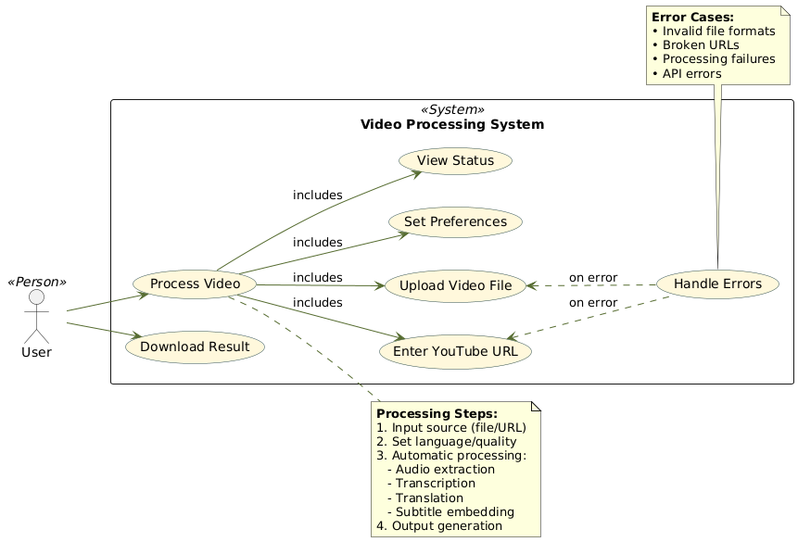
USE CASE - DIAGRAM

Slide 27
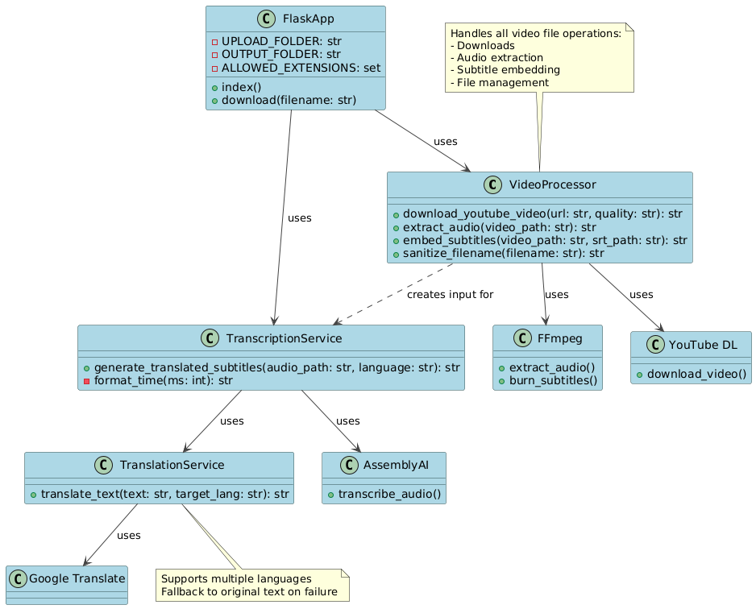
CLASS- DIAGRAM

Slide 28
SEQUENCE - DIAGRAM

Slide 29
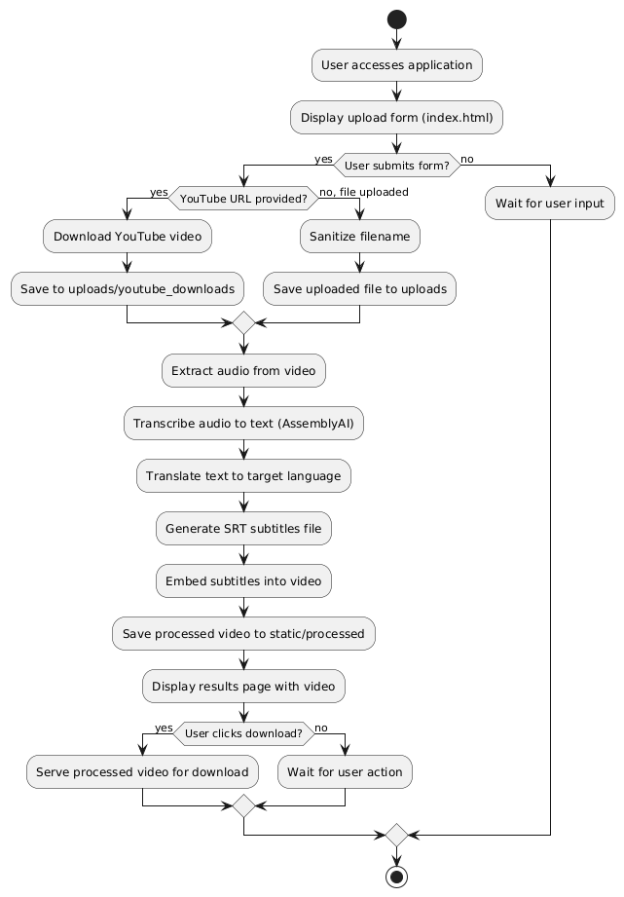
ACTIVITY - DIAGRAM

Slide 30
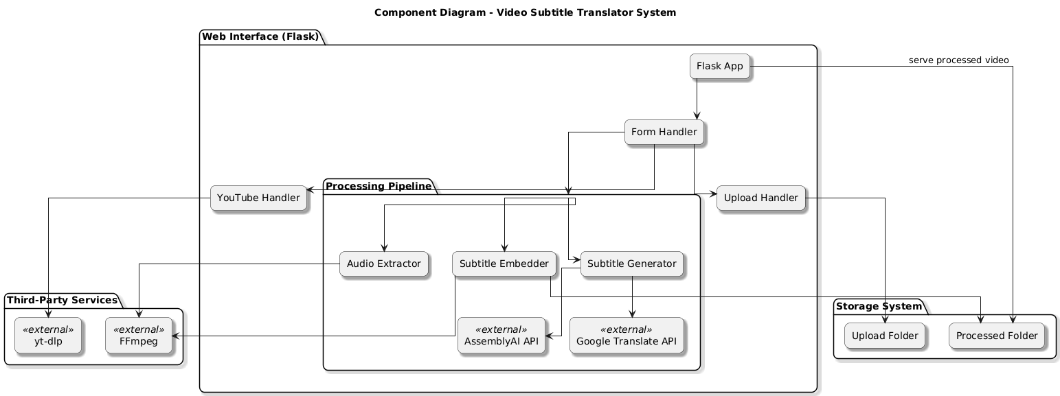
COMPONENT DIAGRAM

Slide 31
Test Case Table
S. No | Test Case Name | Input | Expected Output | Actual Output | Remarks
1 | Upload YouTube video URL | Valid YouTube URL, selected language (e.g., 'hi'), quality (e.g., 'best') | Downloads video to uploads/youtube_downloads, extracts audio, generates subtitles, returns video | Downloads video, processes successfully | Pass
2 | Upload local video file | Valid video file (.mp4, .avi, etc.) | Saves video to uploads/, processes and renders result.html with embedded subtitle video | Saves and processes as expected | Pass
3 | Reject empty file upload | No file selected | Shows error: “No selected file” | Displays correct error | Pass
4 | Reject no input | Neither URL nor file | Shows error: “Please provide either a YouTube URL or upload a file” | Displays correct error | Pass
5 | Extract audio from video | Valid video file | Extracted extracted_audio.mp3 in root directory | Audio extracted using FFmpeg | Pass
6 | Transcribe audio with AssemblyAI | Valid audio file and API key | Returns transcription with timestamps and speaker labels | Transcription successful | Pass
7 | Translate transcription to Hindi | English text and target_lang='hi' | Translated Hindi text using GoogleTranslator | Accurate translation returned | Pass
8 | Handle translation API failure | Force translation API error | Returns original text and logs error | Handled and logged gracefully | Pass

Slide 32
Test Case Table
9 | Generate .srt file with translation | Transcribed and translated content | Creates subtitles.srt with timestamps and speaker tags | Correct .srt generated | Pass
10 | Embed subtitles into video | Original video + subtitles.srt | Returns processed_<video_name>.mp4 with visible subtitles | Subtitles correctly embedded | Pass
11 | Download processed video | Download URL /download/<filename> | File is sent for download from static/processed/ | Video downloaded successfully | Pass
12 | Format time in SRT standard | Milliseconds value | Returns HH:MM:SS,mmm format string | Properly formatted time string | Pass
13 | Invalid YouTube link handling | Invalid/non-video YouTube URL | Raises exception and displays “YouTube download failed” error message | Caught and displayed error | Pass
14 | Disallowed file type | File not in allowed extensions | Reject file with proper error | Validation ensures type restriction | Pass
15 | Speaker separation in transcript | Audio with 2 speakers | Labels utterances with 'Speaker 1', 'Speaker 2' in subtitle lines | Speaker labels correctly displayed | Pass

Slide 33
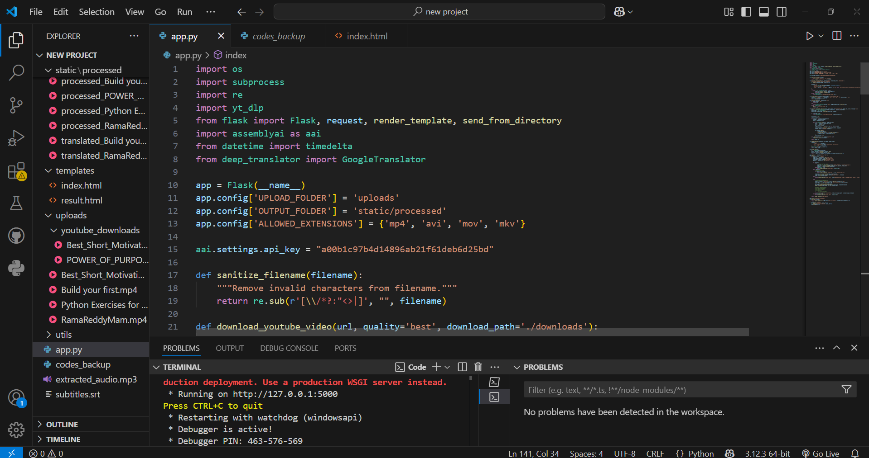
RESULTS – Flask application
Execution of flask application for production deployment

Slide 34
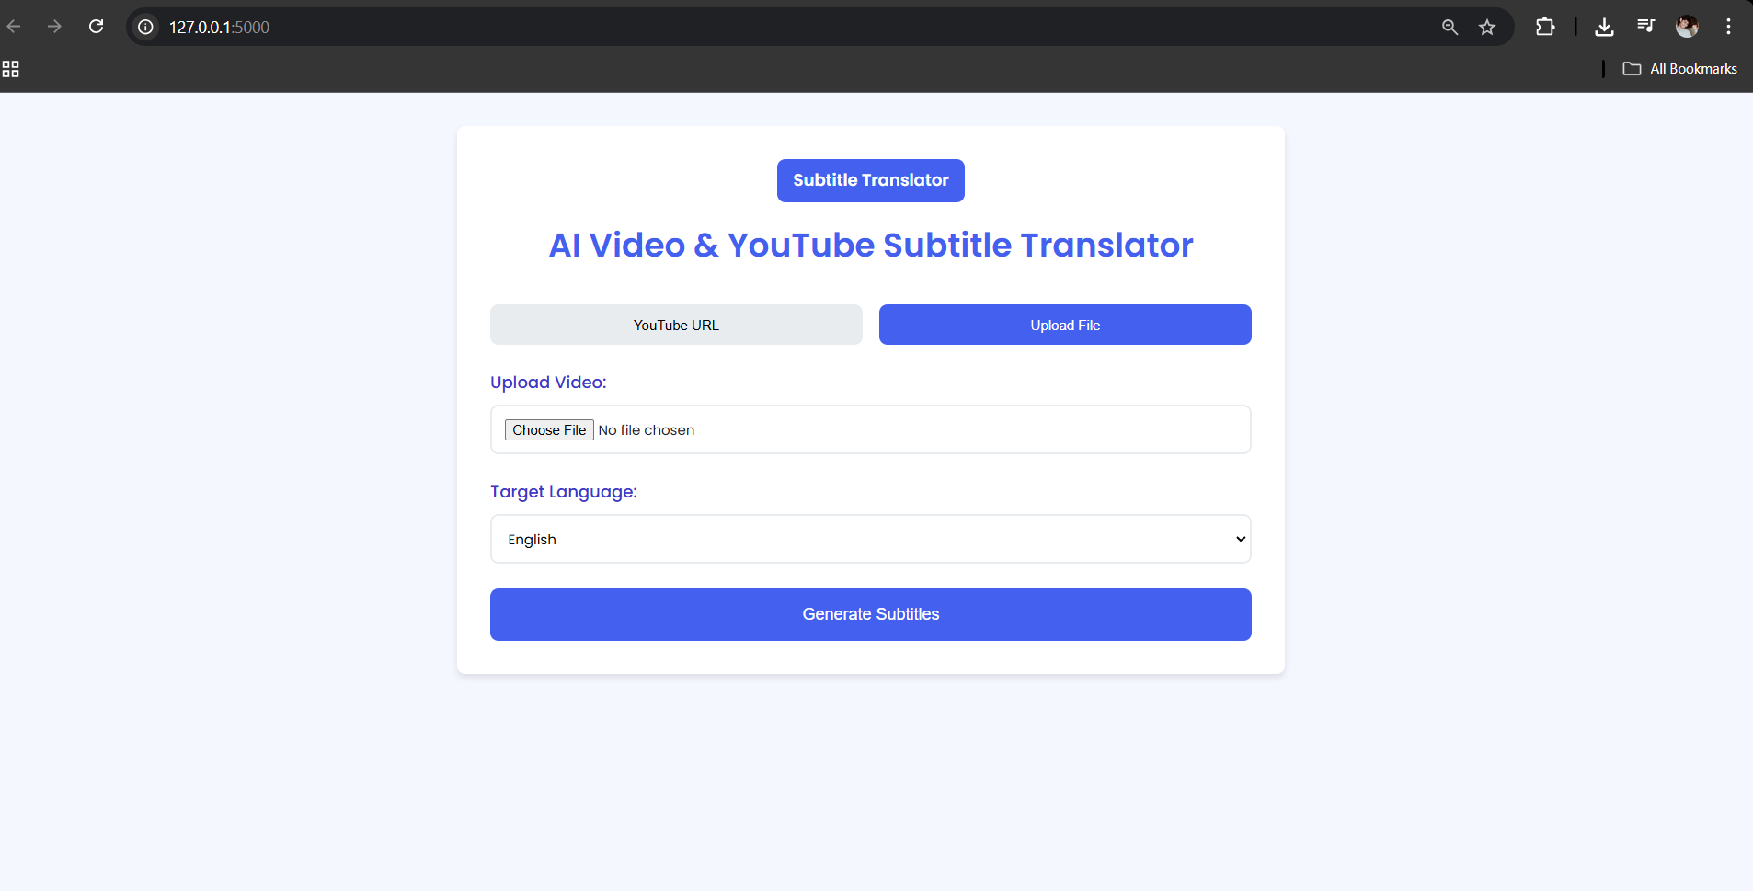
Home Page
Users can upload a video or enter a YouTube URL.

Slide 35
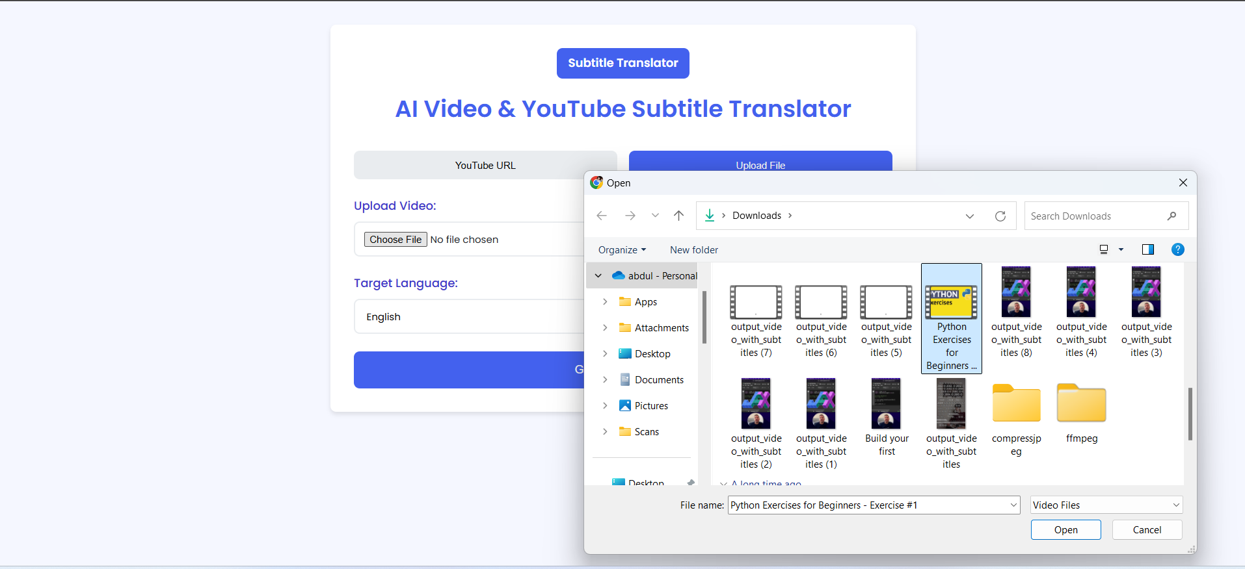
User Uploads Video
Video is either uploaded directly or downloaded from YouTube

Slide 36
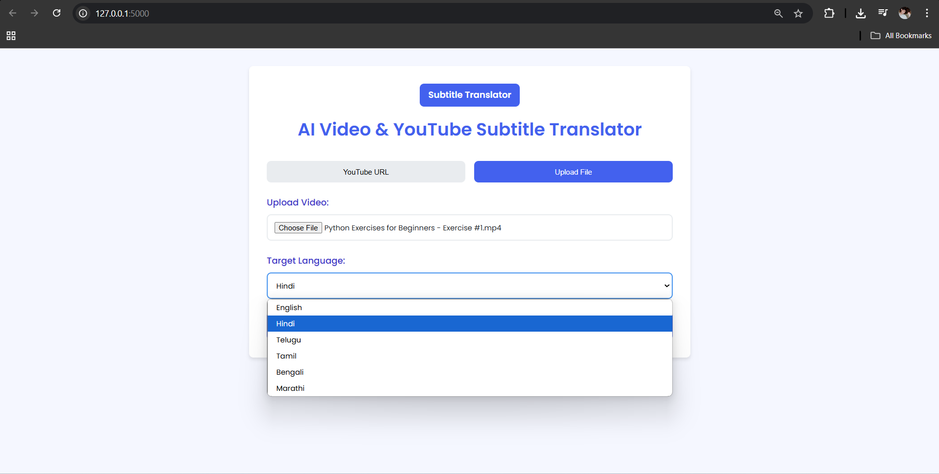
Transcription & Translation
User selects the desired language for translation

Slide 37
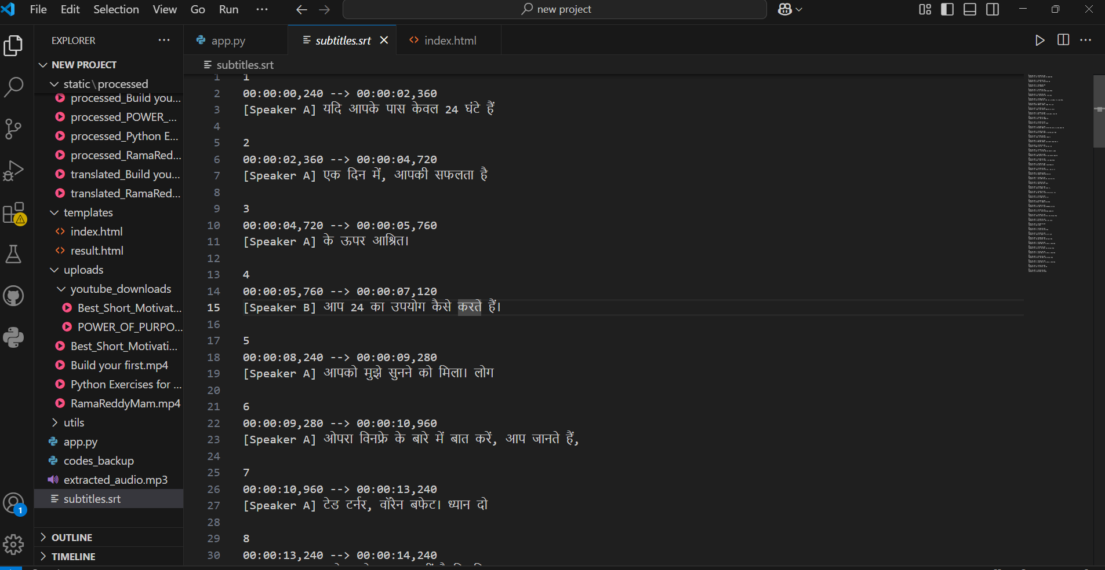
Generated Subtitles in srt
Srt file containing transcribed and translated timestamped subtitles

Slide 38
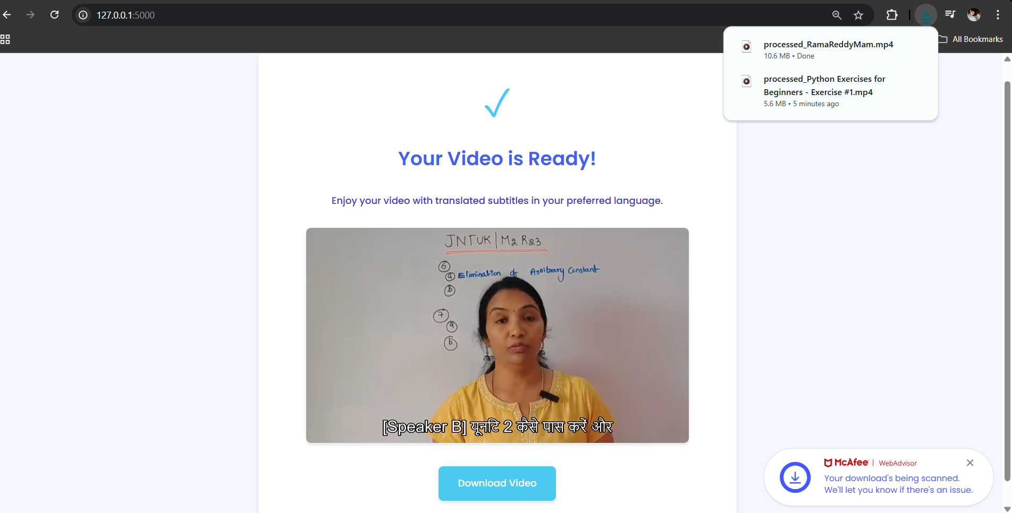
Download Page
User can preview and download the final result [Hindi] .

Slide 39
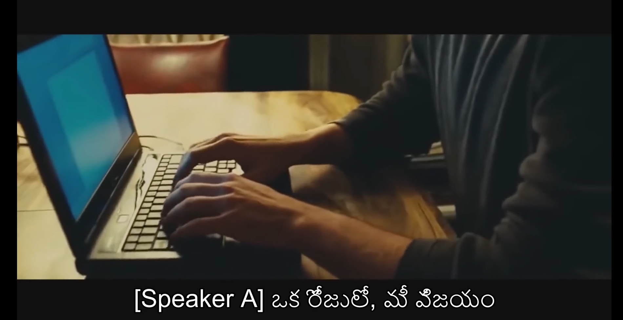
Output video for Telugu
Subtitles synced in Telugu language

Slide 40
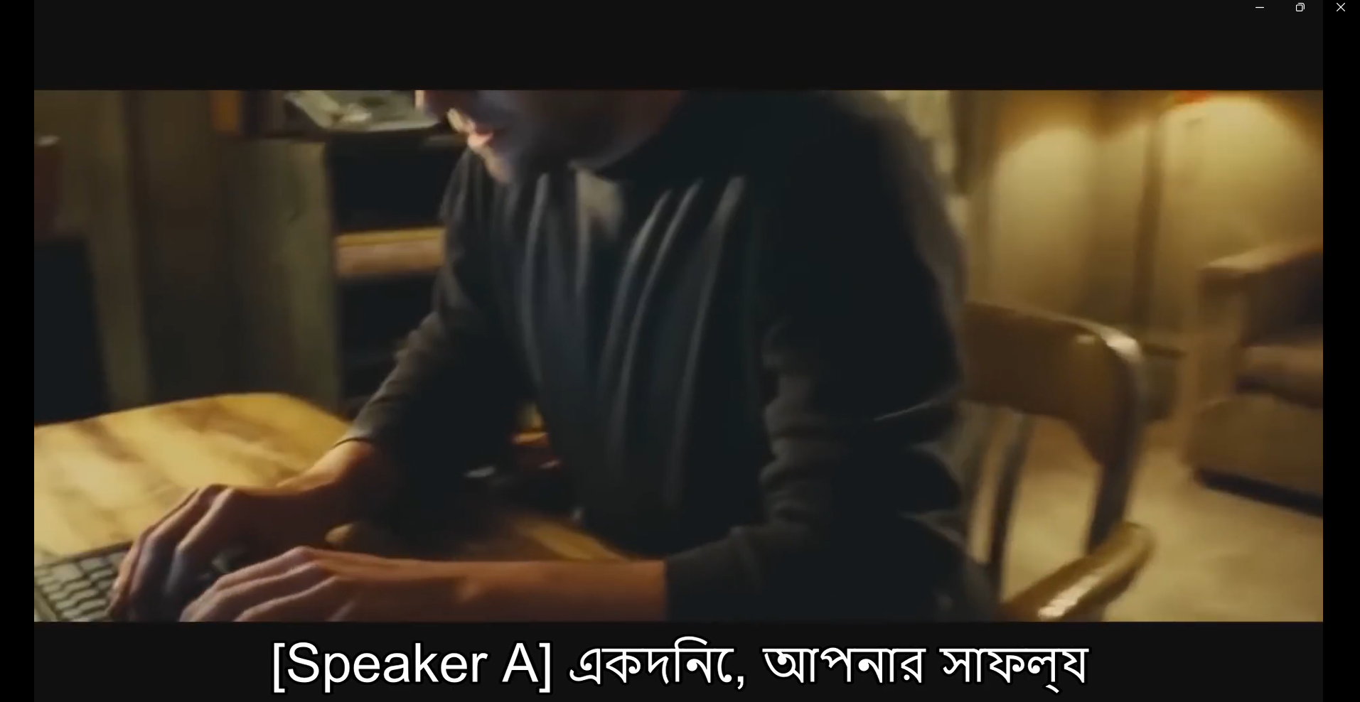
Output video for Bengali
Subtitles synced in Bengali language

Slide 41
Output video for Bengali
Subtitles synced in Bengali language

Slide 42
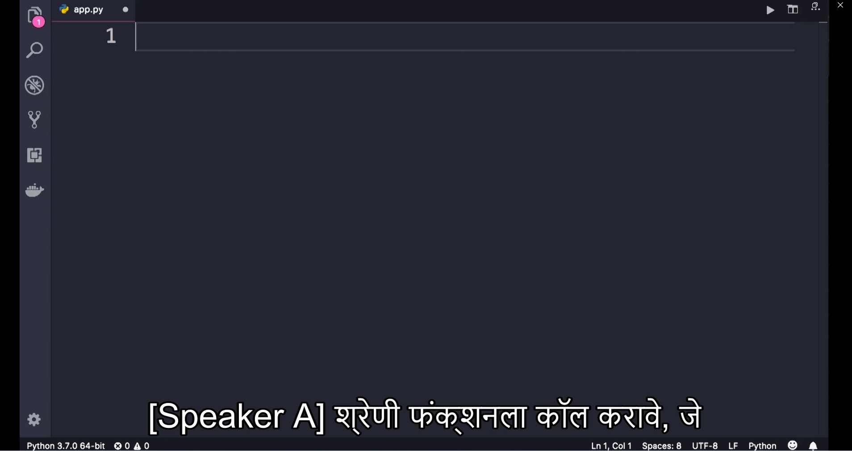
Output video for Marathi
Subtitles synced in Marathi language

Slide 43
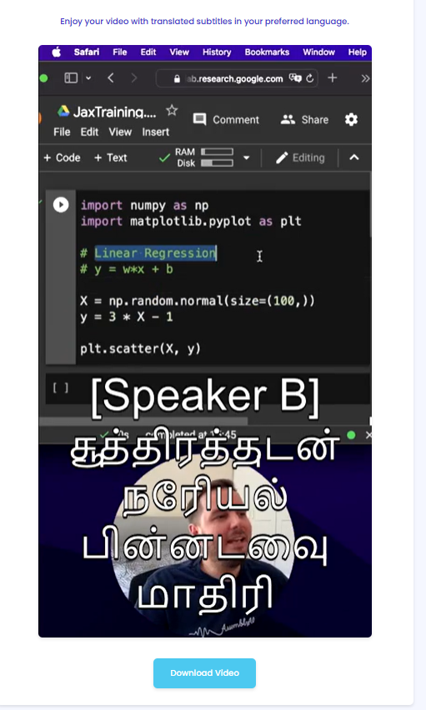
Output video for Tamil
Subtitles synced in Tamil language

Slide 44
Conclusion
The developed system successfully automates subtitle generation by combining audio transcription, language translation, and video processing.
Users can now conveniently upload videos or paste YouTube links and receive translated, speaker-labeled subtitles in a few simple steps.
This solution enhances accessibility and inclusivity by enabling multi-language support for video content.
By integrating tools like AssemblyAI, Google Translate, and FFmpeg, we achieve a seamless, end-to-end workflow for generating localized video content.

Slide 45
Future Scope
Multi-Language Subtitle Support
Allow users to download subtitles in multiple languages at once.
Interactive Subtitle Editor
Provide a web-based interface to edit timestamps or translations before embedding.
Real-Time Subtitling
Expand functionality to enable live transcription and translation for webinars or conferences.
Cloud Integration
Shift processing to cloud platforms for scalability, speed, and storage efficiency.
Improved Speaker Recognition
Use more advanced models for better speaker diarization and emotion detection.
Mobile App Version
Launch an Android/iOS version to make subtitle generation even more accessible on-the-go.

Slide 46
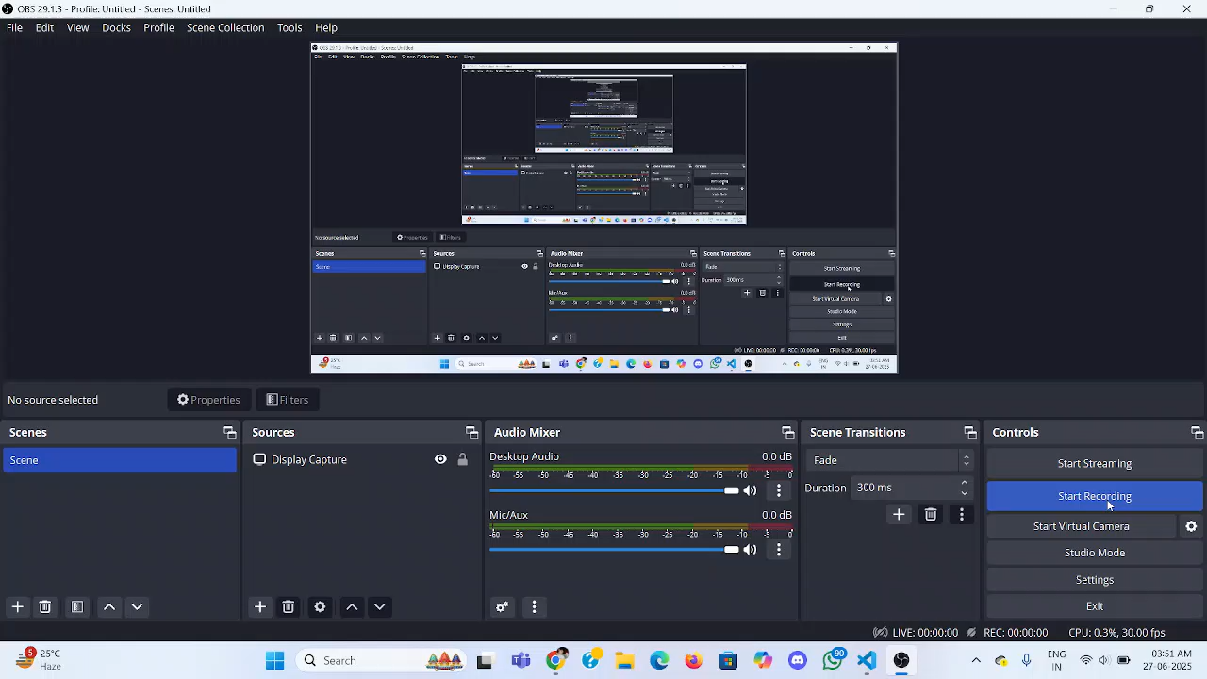
Project execution video
User upload the video from drive

Slide 47
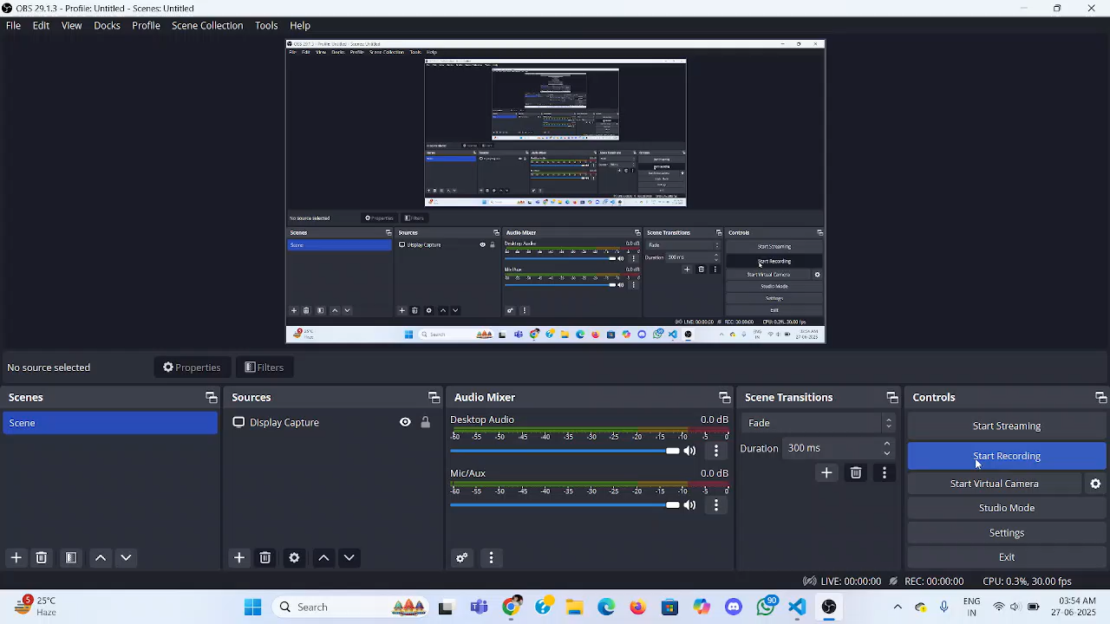
Project execution video
User uploads the video link from youtube

Slide 48
Algorithms
User visits the web page.
A form is displayed with two input options:
Upload a video file from their device
Enter a YouTube video link
When the form is submitted:
If a YouTube link is provided:
The video is downloaded using yt dlp library in best or selected quality
If a video file is uploaded:
The file is saved to a local folder for processing
1. Video Input Module
Algorithm
Take the video file path as input.
Use the FFmpeg tool to extract audio from the video.
Run the command to extract audio in high quality.
Save the extracted audio as an MP3 file.
Return the audio file path for the next step.
2. Audio Extraction Module
Algorithm:
Take the audio file path as input.
Initialize AssemblyAI with the API key.
Configure transcription with speaker labels enabled.
Send the audio to AssemblyAI for transcription.
Receive the transcript with speaker-wise word chunks.
Return the transcript data for subtitle generation.
3. Transcription Module
Algorithm :

Slide 49
Receive English transcript as input.
Use GoogleTranslator (from deep_translator) to auto-detect source language.
Set target language as per user selection from the UI.
Translate each sentence or chunk using GoogleTranslator.
Pass translated text to subtitle generation module.
4. Translation Module
Algorithm / Technique Used:
Receive translated text and corresponding timestamps.
Chunk words into groups (e.g., 6 words per subtitle line).
Use `timedelta` to format start and end time into SRT format.
Add speaker labels (e.g., [Speaker 0]).
Write formatted subtitles to a `.srt` file.
5. Subtitle Generation Module
Algorithm / Technique Used:
Take input video file and generated `.srt` subtitle file.
Use FFmpeg subtitle filter to embed subtitles:
Command: ffmpeg -i input.mp4 -vf subtitles=subtitles.srt -c:a copy output.mp4
Set subtitle styling (e.g., font size = 24).
Generate final video with hardcoded (burned-in) subtitles.
6. Subtitle Embedding Module
Algorithm / Technique Used:

Slide 50
REFERNECES
[1] A. Moryossef, "sign.mt: Real-Time Multilingual Sign Language Translation Application," arXiv preprint arXiv:2310.05064v2, Aug. 2024. [Online]. Available: https://arxiv.org/abs/2310.05064
[2] A. Moryossef, Real-Time Multilingual Sign Language Processing (Ph.D. dissertation), Dept. of Computer Science, Bar-Ilan Univ., Ramat Gan, Israel, 2023. [Online]. Available: https://arxiv.org/abs/2412.01991
[3] B. Mocanu and R. Tapu, "Automatic Subtitle Synchronization and Positioning System Dedicated to Deaf and Hearing Impaired People," IEEE Access, vol. 9, pp. 139544–139555, 2021, doi: 10.1109/ACCESS.2021.3119201.
[4] X. Che, S. Luo, H. Yang, and C. Meinel, "Automatic Lecture Subtitle Generation and How It Helps," in Proc. 2017 IEEE 17th Int. Conf. Advanced Learning Technologies (ICALT), Timisoara, Romania, 2017, pp. 34–38, doi: 10.1109/ICALT.2017.11.
[5] S. K. Pulipaka, C. K. Kasaraneni, V. N. S. Vemulapalli, and S. S. M. Kosaraju, "Machine Translation of English Videos to Indian Regional Languages Using Open Innovation," in Proc. 2019 IEEE Int. Symp. Technology and Society (ISTAS), Medford, MA, USA, 2019, pp. 1–7, doi: 10.1109/ISTAS48451.2019.8937988.

Slide 51
Reference | Method | Limitations
[1] | Moryossef et al.Developed sign.mt, a real-time multilingual sign language translation system using a modular pipeline (STT, language identification, normalization, SignWriting, and avatar rendering). | Incomplete automation of certain stages like SignWriting to animation Inconsistent performance due to modularity and varying model quality
[2] | Proposed SignWriting as a universal intermediate representation for Sign Language Processing; developed gloss translation, pose datasets, and translation pipelines. | Scalability issues in covering all sign languages Requires-high-quality datasets, which are limited for many languages
[3] | Designed an automatic subtitle synchronization system using ASR and semantic content analysis for subtitle positioning. | ASR quality impacts alignment accuracy Best suited for replay scenarios, not live broadcast
Reference | Proposed Method | Limitations
[4]
Inspired the idea of multimodal accessibility; you implemented a Flask-based web app that accepts YouTube links or uploads and processes video/audio for subtitle embedding. | Sign language rendering not implemented; limited to subtitle generation only
[5] | Bulit’s own pipeline for processing spoken content into translated subtitles using AssemblyAI and deep-translator, bypassing complex intermediate representations like SignWriting | Only supports translation to single language at a time No support for gloss-based or structural linguistic models
[6] | Integrated a subtitle synchronization flow using AssemblyAI’s timestamped transcription, with per-speaker labeling to help deaf users. | Subtitle placement is fixed (burned-in), not dynamically positioned based on scene content

